Slide 1
SECURE DATA HIDING IN IMAGES USING STEGANOGRAPHY
CAPSTONE PROJECT
Presented By:
Student Name : Lingesh R
Department : Information Science and Engineering
College Name: Vemana Institute of Technology

Slide 2
OUTLINE
Problem Statement
Technology used
WOW factors
End users
Results
Conclusions
Future scope
GitHub Link

Slide 3




Problem Statement
Develop a secure data transmission interface that embeds encrypted messages within digital images using advanced steganographic techniques. The solution conceals the existence of hidden information, ensuring that sensitive data remains undetectable to unauthorized parties. Users can flexibly input their messages either by typing directly or by selecting a text file, enhancing the system’s versatility. The application is modularized into distinct components for encoding and decoding, improving maintainability and scalability, while an intuitive graphical interface simplifies user interaction and overall usability.
Objectives
Securely embed encrypted messages into digital images using advanced steganographic techniques.
Conceal the presence of hidden data to prevent detection by unauthorized parties.
Offer flexible input options by allowing users to either type messages or select text files.
Modularize the solution into separate encoding and decoding components to enhance maintainability and scalability.

Slide 4
Technology used
Libraries Used:
tkinter: For creating the graphical user interface (GUI).
pillow (PIL): For image processing and manipulation.
stepic: For embedding and extracting hidden messages (steganography).
hashlib: For generating secure hash values for key derivation.
crypto (PyCryptodome): Specifically, the AES module for performing AES encryption and decryption.
base64: For encoding and decoding binary data into a text format.
datetime: For generating timestamps used in logging operations.
os: For interacting with the operating system (file management, path operations).
csv: For logging operations into a CSV file.
Platforms:
Developed in Python 3, making it cross-platform and compatible with Windows, macOS, and Linux environments.
Tools:
IDLE/PyCharm/VS Code: Recommended IDEs for coding and debugging.
Command Line/Terminal: Running scripts and testing functionalities.

Slide 5
Wow factors
Enhanced Layer Security: Can choose different encryptions with steganography for maximum protection.
Invisible Data Concealment: Ensures hidden data remains undetectable.
Flexible Input: Supports manual text entry and file uploads.
Algorithm & Password Verification: Prevents unauthorized decryption with strict validation.
Modular Design: Separate encryption, decryption, and GUI components for scalability.
Robust Error Handling: Detects wrong passwords, incorrect algorithms, or corrupt files.
User-Friendly Interface: Simplified Tkinter-based GUI for easy use.
Fast & Lightweight: Optimized for quick processing with minimal resource usage.
Cross-Platform Support: Works on Windows, macOS, and Linux.
Log Management: Tracks embedding and extraction for added traceability.

Slide 6
End users
1. Journalists & Activists
2. Government & Défense Agencies
3. Corporate Organizations
4. Researchers & Academicians
Securely transmits sensitive information without detection.
Protects classified communications from cyber threats.
Safeguards confidential business data from industrial espionage.
Explores advanced cryptography and steganography techniques.
5. Cybersecurity Professionals
6. Forensic Experts
7. Privacy Enthusiasts
Implements and tests secure data transmission methods.
Detects and analyze hidden data for investigative purposes.
Ensures personal data remains private and secure.

Slide 7
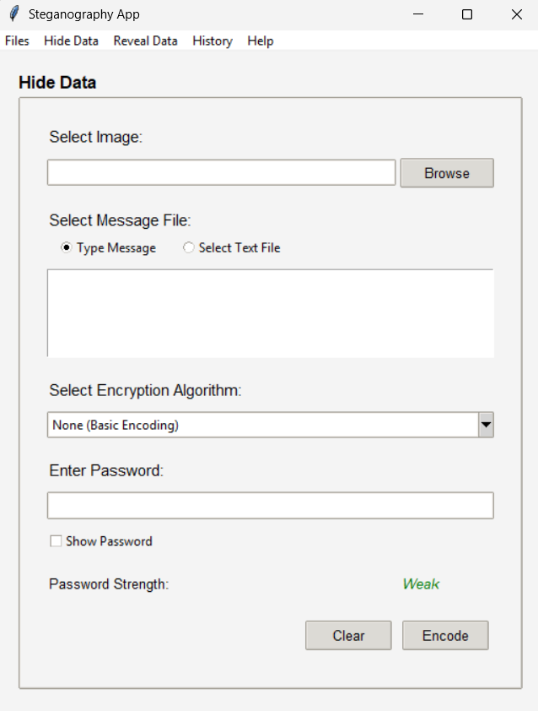
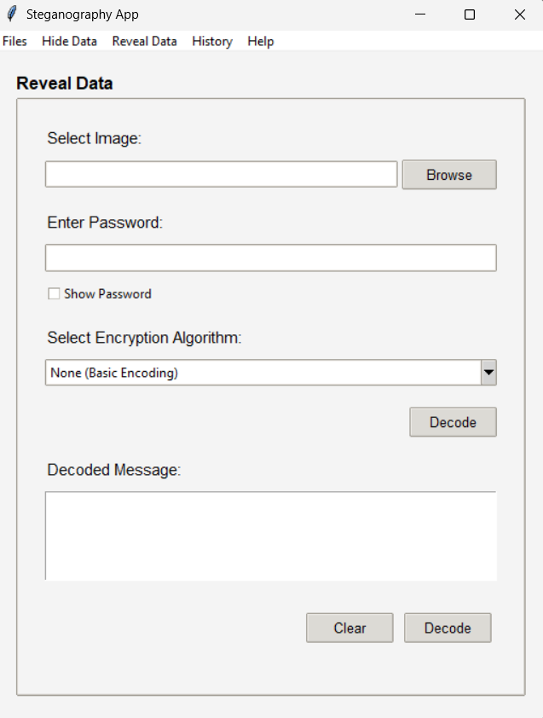
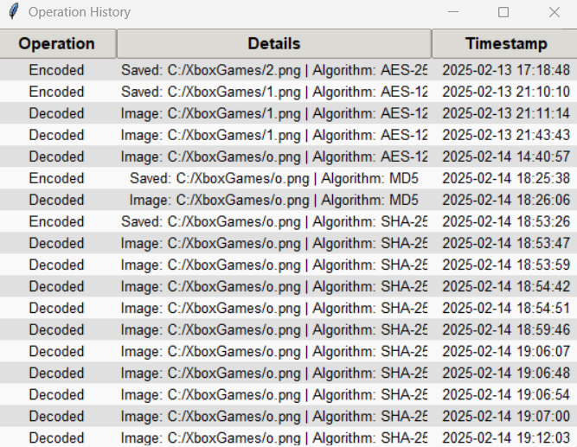
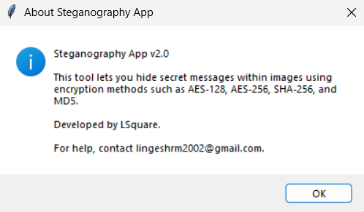
Results

Slide 8
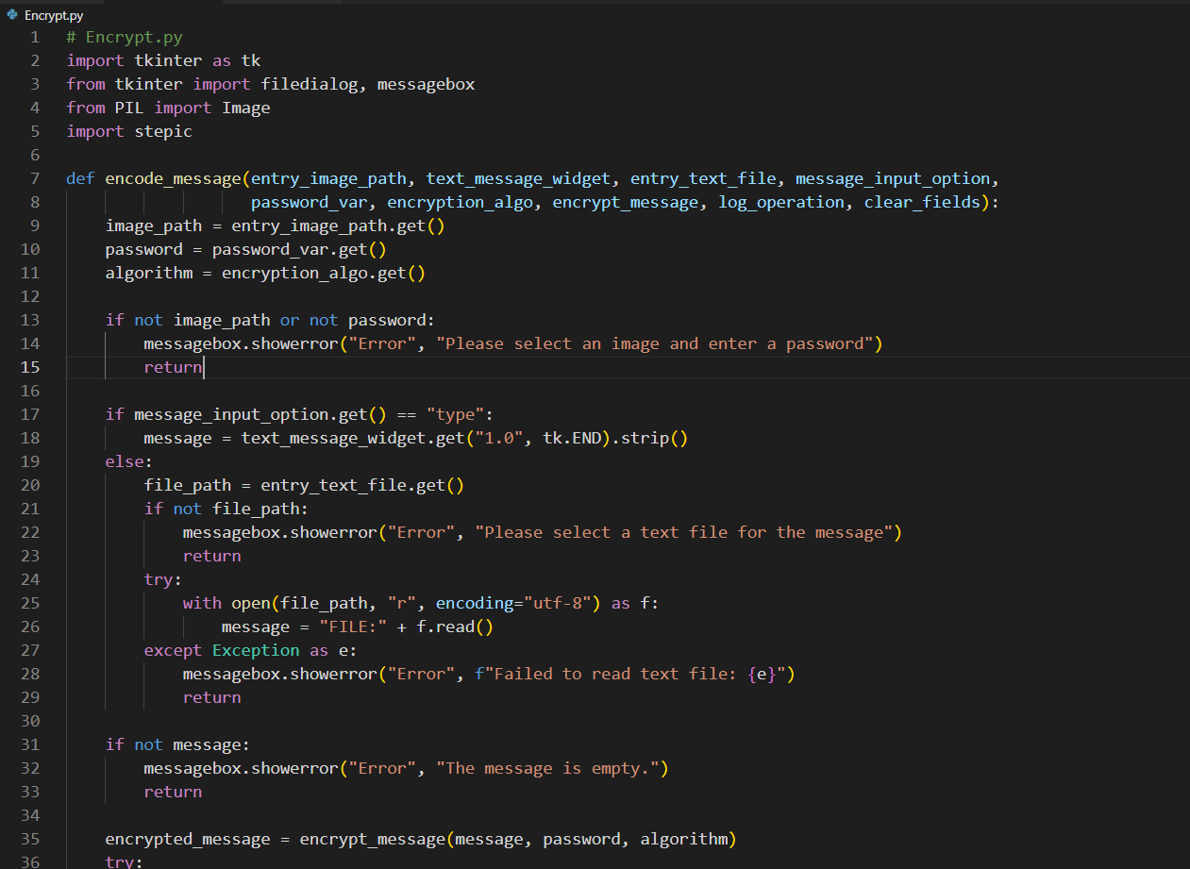
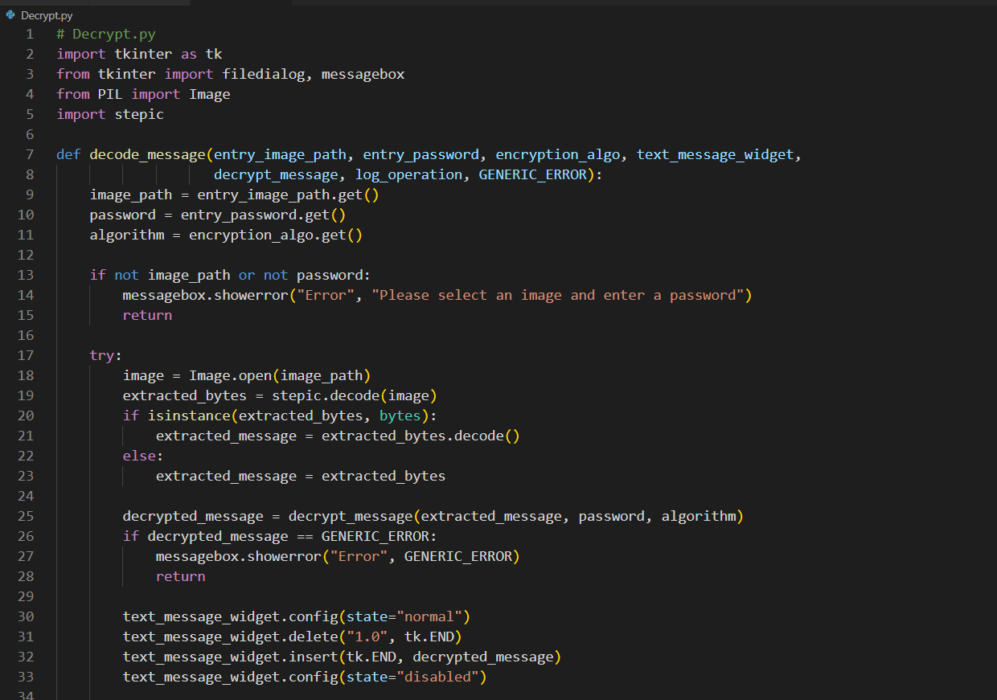
Results

Slide 9
Conclusions
Ensures secure communication by embedding encrypted messages within images, making detection difficult.
Uses advanced steganographic techniques to conceal data, preventing unauthorized access.
Simplifies secure data transmission with an intuitive GUI for easy encoding and decoding.
Separating encryption and decryption into different modules enhances maintainability and future expansion.
Allows users to enter messages manually or upload text files, increasing flexibility.
Useful for government, corporate, cybersecurity, and personal data protection needs.
Returns precise error messages when decryption fails due to incorrect passwords or algorithms.

Slide 10
Future scope
Extending compatibility to JPEG, PNG, BMP, and GIF for broader usability.
Hiding data within multiple layers of an image to increase robustness.
Integrating anti-detection techniques to prevent forensic analysis from exposing hidden data.
Enabling secure cloud integration for encrypted image storage and retrieval.
Developing a cross-platform app for Android, iOS, and web.
Enabling secure real-time communication via steganography over messaging platforms.
Use of AI/ML models to pick images with optimal noise patterns for better data concealment.
Allow multiple files to be encoded/decoded simultaneously for efficiency.
Enhancing data integrity and verification using decentralized blockchain records.

Slide 11

GitHub Link
https://github.com/Lingesh81051/Steganography-App.git

Slide 12
THANK YOU

